Slide 1

FOUNDER
Final Pitch
ChargeMate
Everyday Friction
Sarah Stantial · Shannon Cullen · Ryan Jankowski · Rohan Pratap Reddy Ravula · Annanahmed Shaikh

Slide 2
The Problem
Not always having the right cable/adapter when you need it and not being able to use someone else's.
Why This Matters:
Wastes time looking for the correct charger
Dead devices during traveling or paying another charger
Carrying multiple chargers causes tangling and wasted time
Waste money and productivity getting a new cable

Slide 3

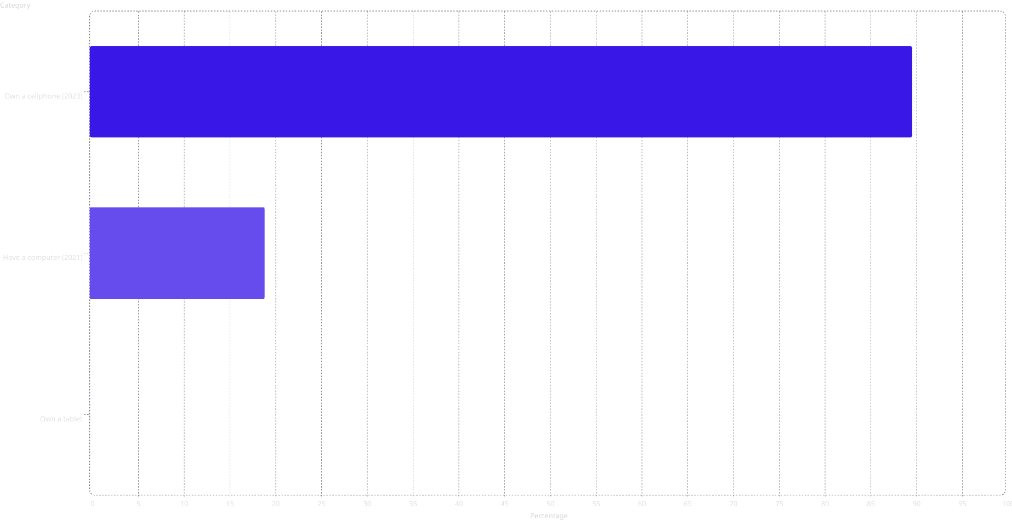

Who Is Affected
Who is affected by this? The scale of this problem is vast. Virtually every American carries a device — and the majority carry several. The charging cable problem isn't a niche inconvenience; it's a universal daily friction point affecting hundreds of millions of people.
Statistics:
98
81
People We've Directly Talked to:
62
Industry workers
Office workers
Students
Travelers
All ages

Slide 4
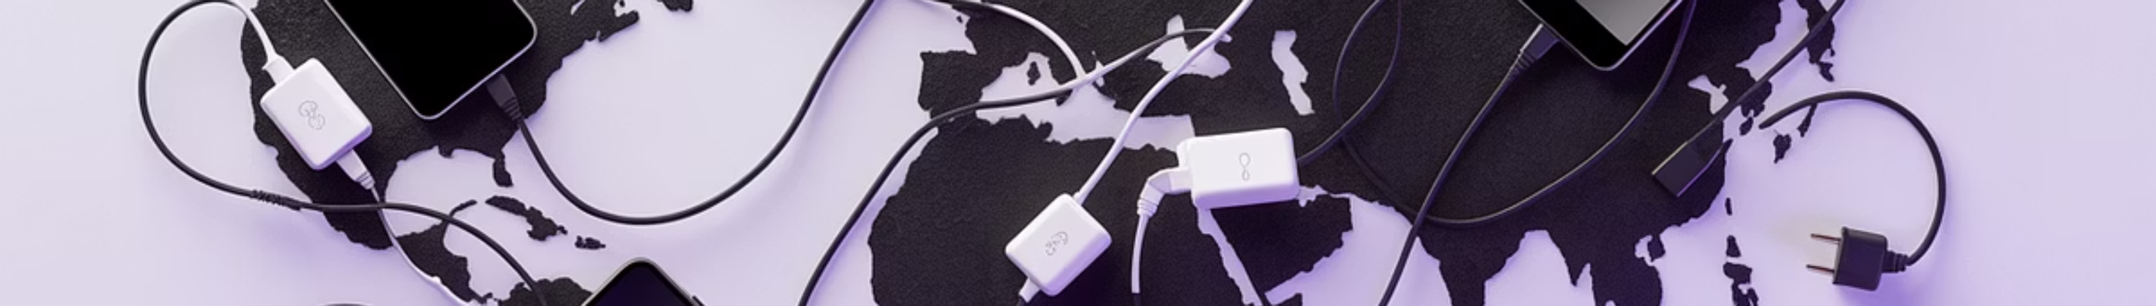
Industry Context
Growing Dependence on Multi-Device Connectivity:
Fragmented Charging & Adapter Market:
Rising Mobility & Travel Demand:
Professionals and students increasingly rely on constant connectivity for productivity and communication
Current solutions are disconnected
Growth in remote work, travel, and digital lifestyles increases need for portable power solutions International travel introduces incompatible plug standards (US, EU, UK, etc.)
Consumer Behavior: Workarounds ≠ Solutions:
Market Opportunity:
Global travel adapter market estimated at ~$1–2.4B and growing Opportunity exists for a fully integrated, all-in-one charging system
Users carry multiple chargers, buy duplicates, or rely on partial fixes These solutions create clutter, inefficiency, and added cost

Slide 5

Implementation
Strategic Investors & Partners:
Companies like Google, Apple, Amazon, HP, Samsung, and Dell have enormous incentive to support a solution — fixing a problem their own users experience daily directly boosts loyalty, reputation, and revenue.

Slide 6
Manufacturing Plan
Weight: approx. 12-14 oz
Size: 150mm × 50mm × 30–77mm
Manufacturing: The casings will be injection molded with plastic, and the components will be soldered together and inserted into the casing.
How will we actually produce it?
1
2
Partner with a Contract Manufacturer (OEM/ODM)
Provide Our Design + Requirements
3
4
Send manufacturer:
Tooling & Setup
CAD model (your MVP)
Functional requirements (battery size, ports, voltage, etc.)
Create injection molds for the outer casing
Set up assembly line

Slide 7
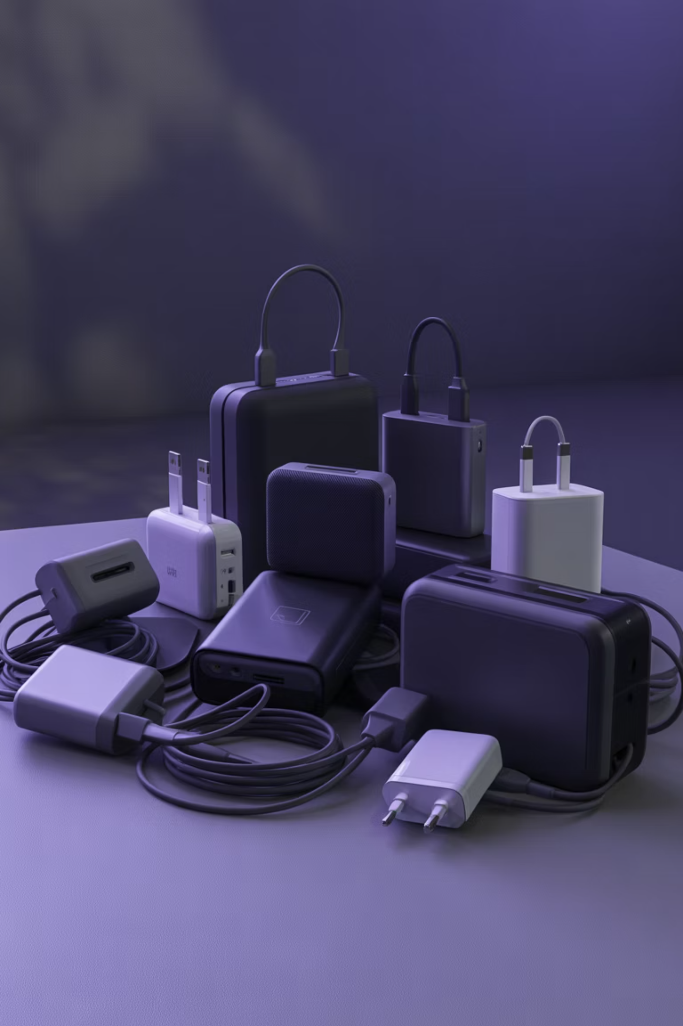
Competitors
Travel Adapters
1
e.g., Vintar
Portable Chargers / Power Banks
2
e.g., Ansody
Cable Converters
3
e.g., YBBGANTE
Key Market Gap:
Users must carry multiple separate devices
Existing products solve one piece of the problem, not the full experience
No solution delivers power + conversion + cable management in one system

